Slide 1
Microsoft - New Horizons
A detailed analysis of the International Movie Industry

Slide 2

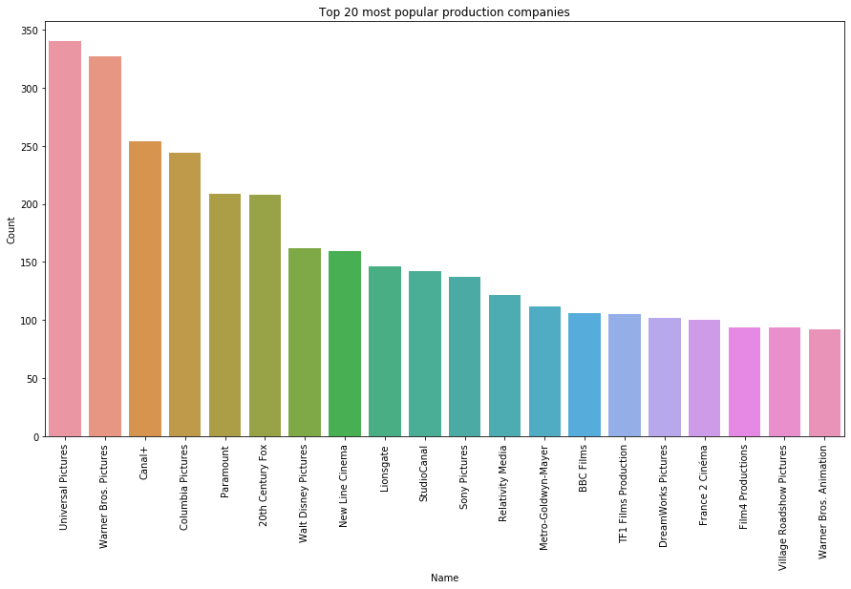
Competition: Which Production Companies create the most movies?

Slide 3
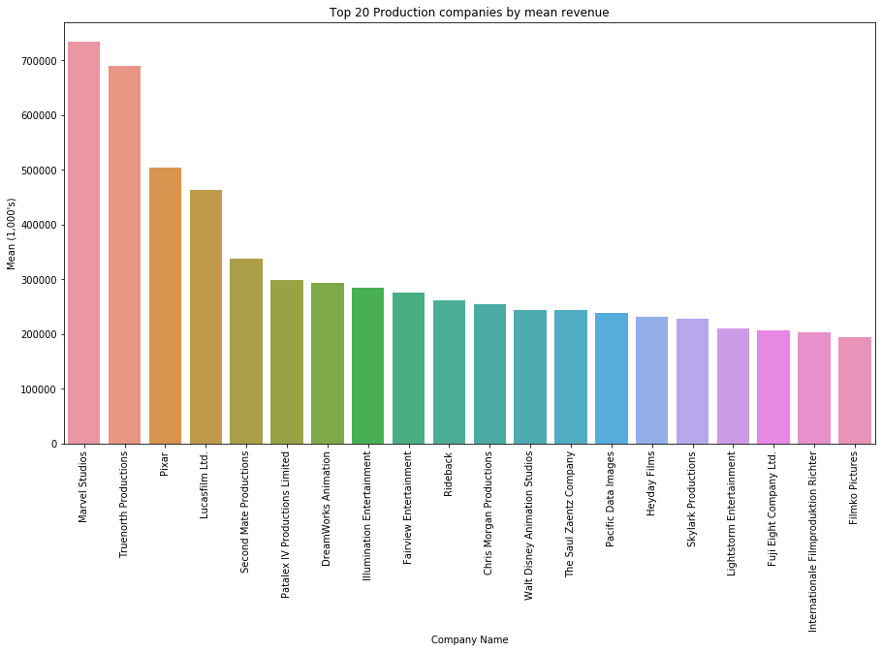
Competition: Which Production Companies create the highest-grossing movies?

Slide 4
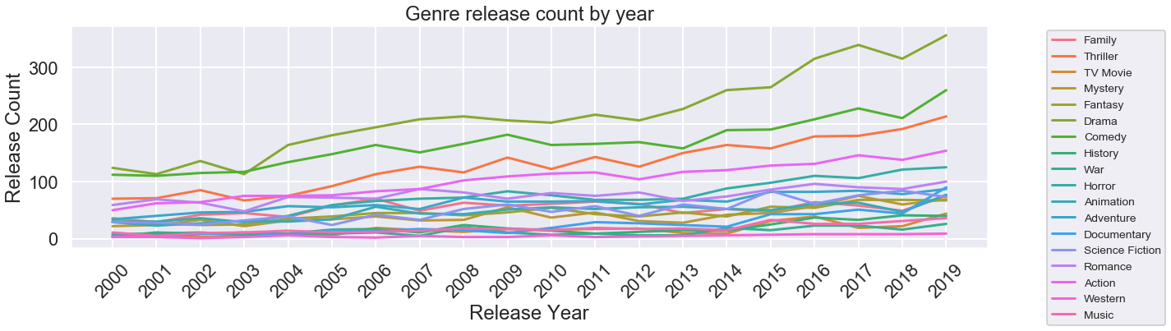
Genres: How has genre popularity changed over the years?

Slide 5
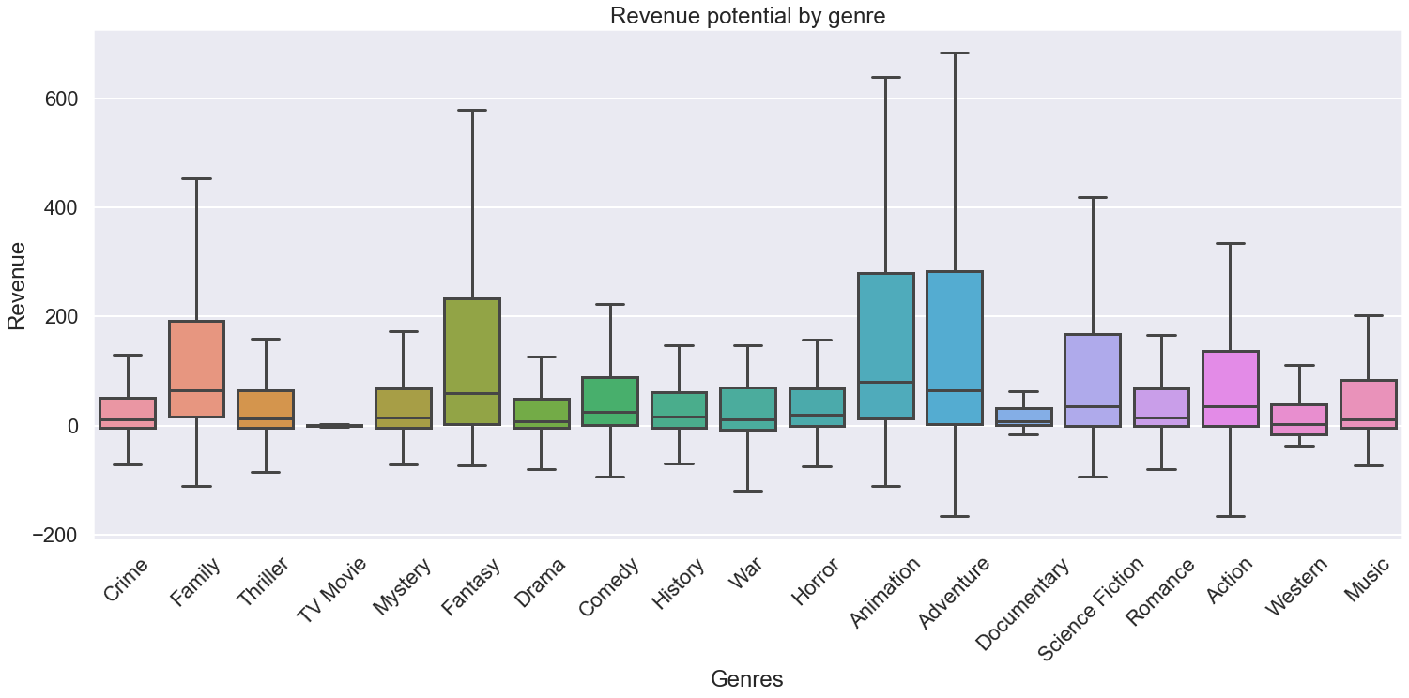

Genres: Which are the most profitable genres?

Slide 6
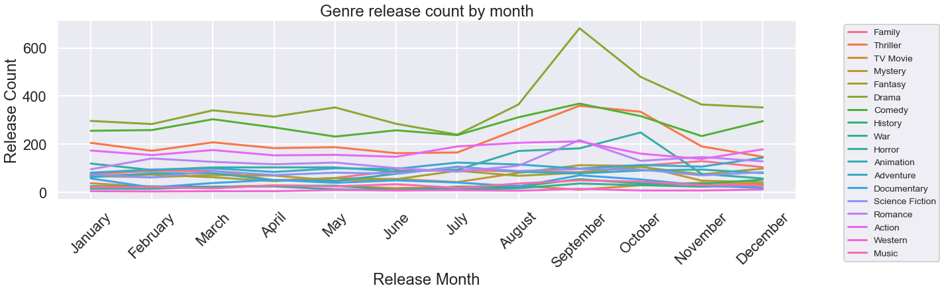
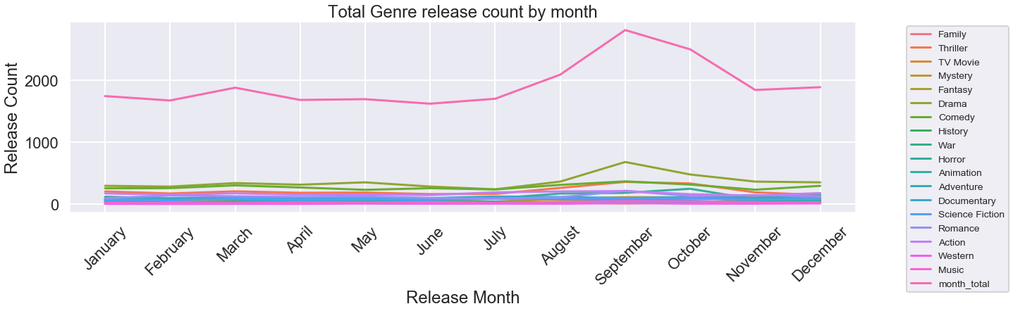
Release Month: Which month are movies typically released, by genre?

Slide 7
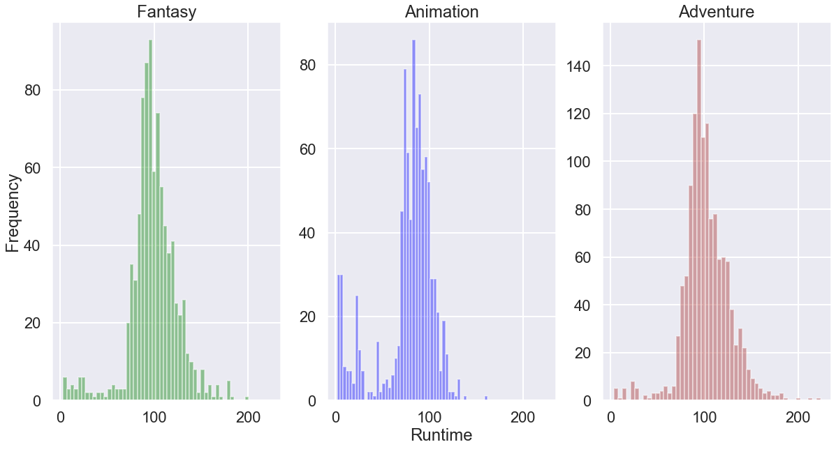
Runtime: What is the typical runtime for Fantasy, Animation, and Adventure movies?

Slide 8
Recommendations
Competition:
Investigate the operations of production companies such as Universal Pictures and Warner Brothers to optimize your movie production output
Focus on developing large franchises like those owned by Marvel and Lucasfilms in order to maximize total revenue at the box office
Genres:
Avoid genres like Drama, Comedy, and Thriller as these are highly saturated
Focus on developing Fantasy, Adventure, and Animation movies as these return the highest profit
Release Month:
Avoid releasing films in “Dump Months” such as September, as you will have increased competition.
Runtime:
Based on our analysis, the typical Fantasy, Animation, and Adventure genres are typically 90-100 minutes in duration.

